Slide 1


Rockbuster Stealth Transitions to Online video rental service
-Ngawang Dhundup

Slide 2

Background
Rockbuster Stealth LLC is a movie rental company that used to have stores around the world. Facing stiff competition from streaming services such as Netflix and Amazon Prime, the Rockbuster Stealth management team is planning to use its existing movie licenses to launch an online video rental service in order to stay competitive.

Slide 3
KEY QUESTIONS & OBJECTIVES
Which movies contributed the most/least to revenue gain?
What was the average rental duration for all videos?
Which countries are Rockbuster customers based in?
Where are customers with a high lifetime value based?
Do sales figures vary between geographic regions?

Slide 4


BRIEF OVERVIEW
Current Film Licenses | Total Customers | Countries & Cities currently in | Average Revenue Per Rental | Average Rental Duration
1000 | 599 | 109 Countries 600 Cities | $2.98 | 5 Days

Slide 5
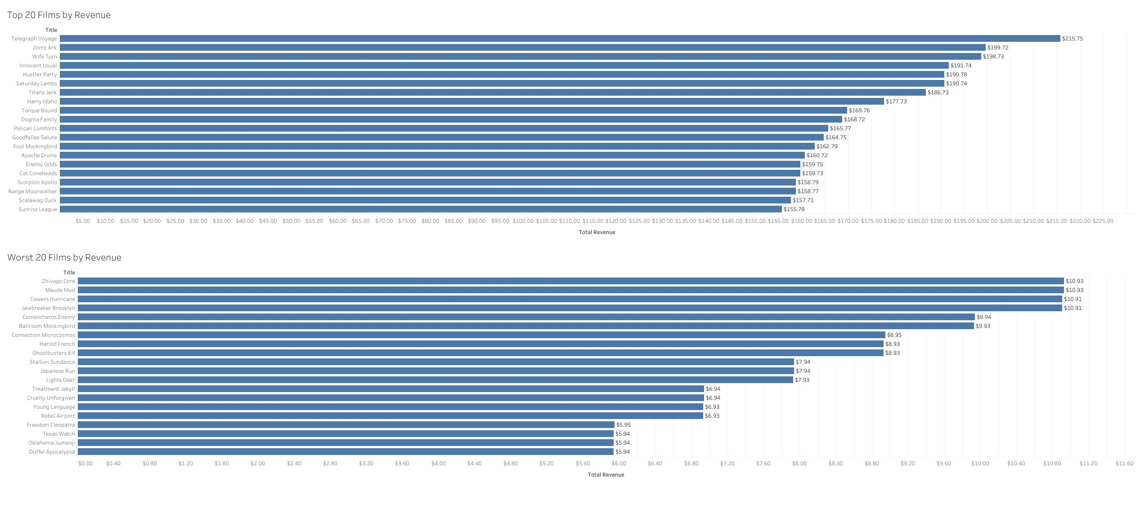
BEST AND WORST FILMS BY REVENUE

Slide 6
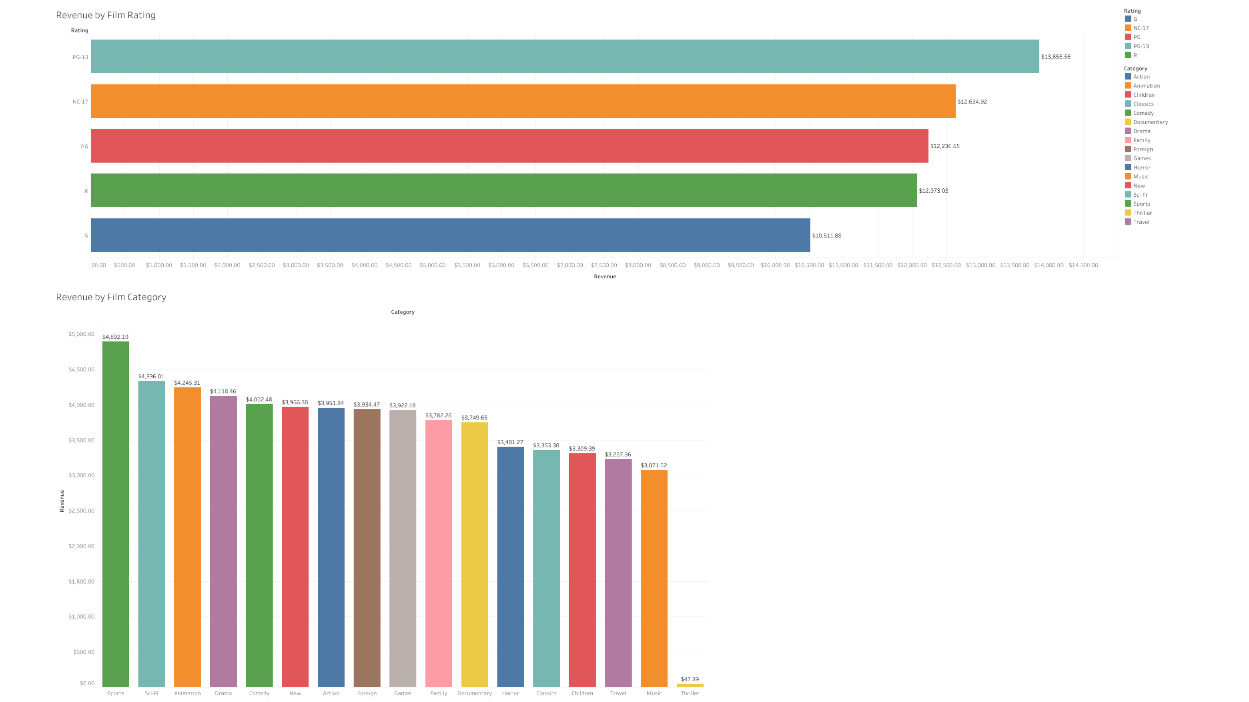
Revenue by rating and Film Category

Slide 7
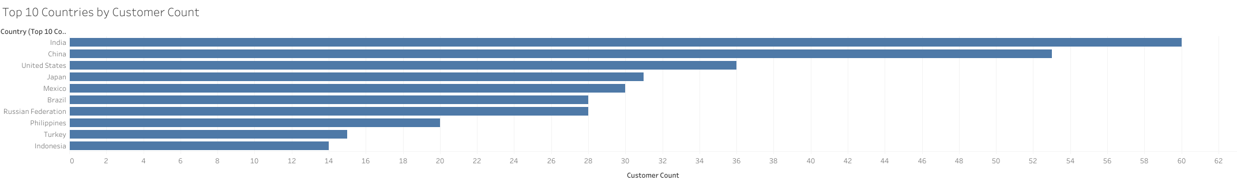
Top 10 countries by customer count
Top 10 Countries by Revenue
1 | India | 6 | Brazil
2 | China | 7 | Russian Federation
3 | United States | 8 | Phillipines
4 | Japan | 9 | Turkey
5 | Mexico | 10 | Indonesia

Slide 8
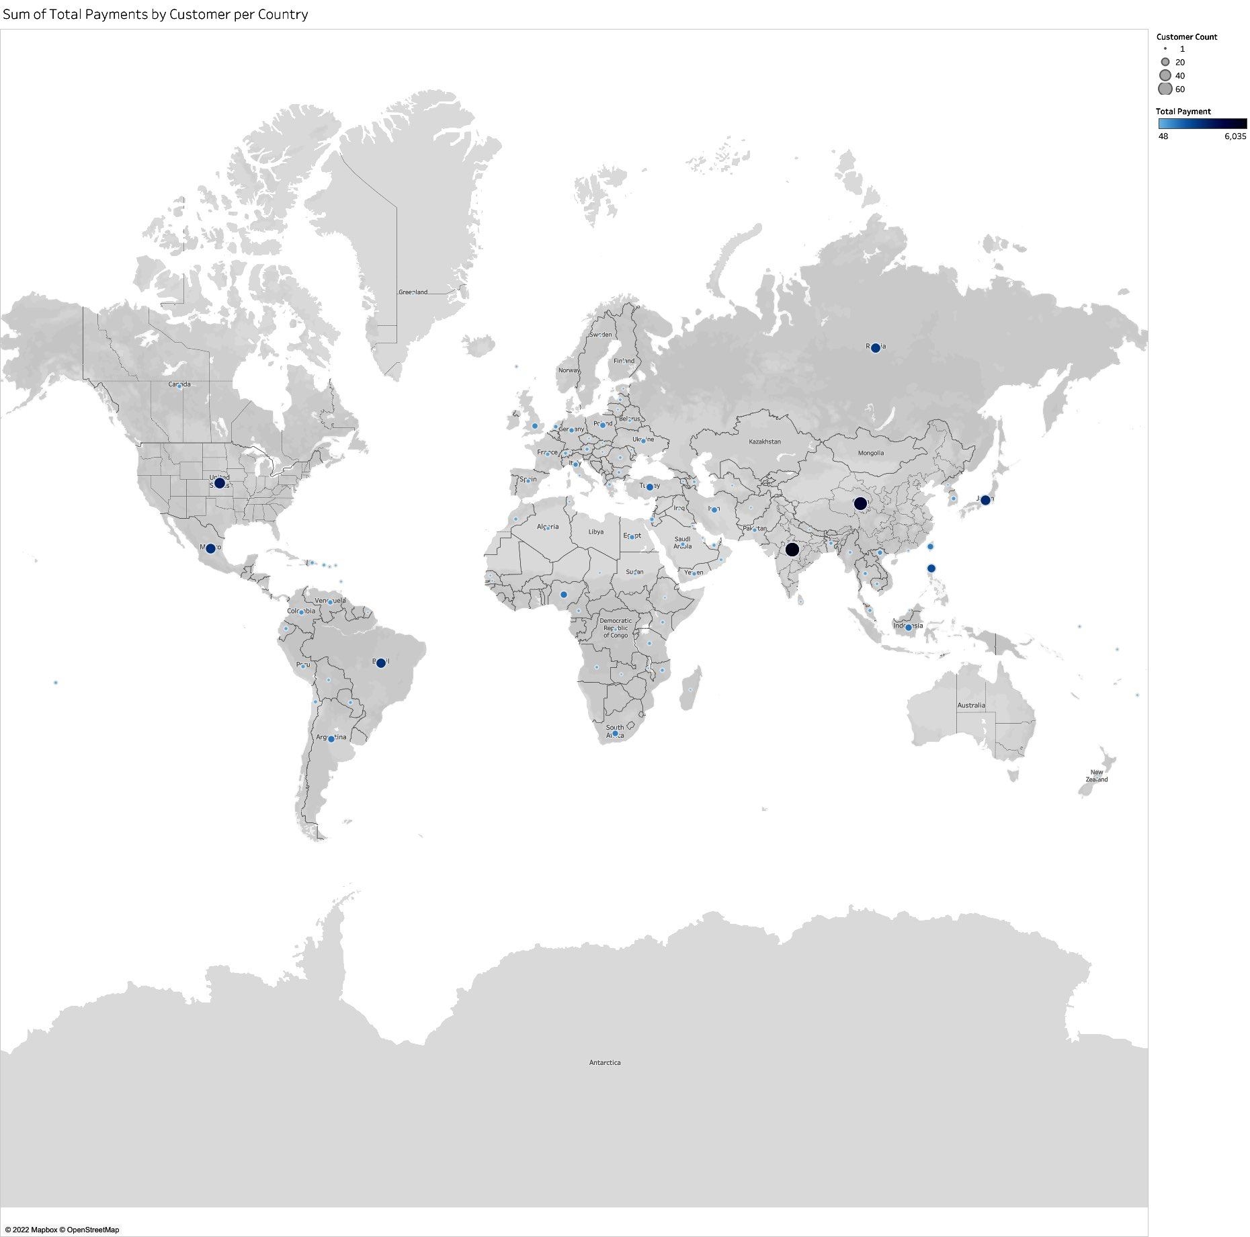
Markets by customer size and revenue gain

Slide 9
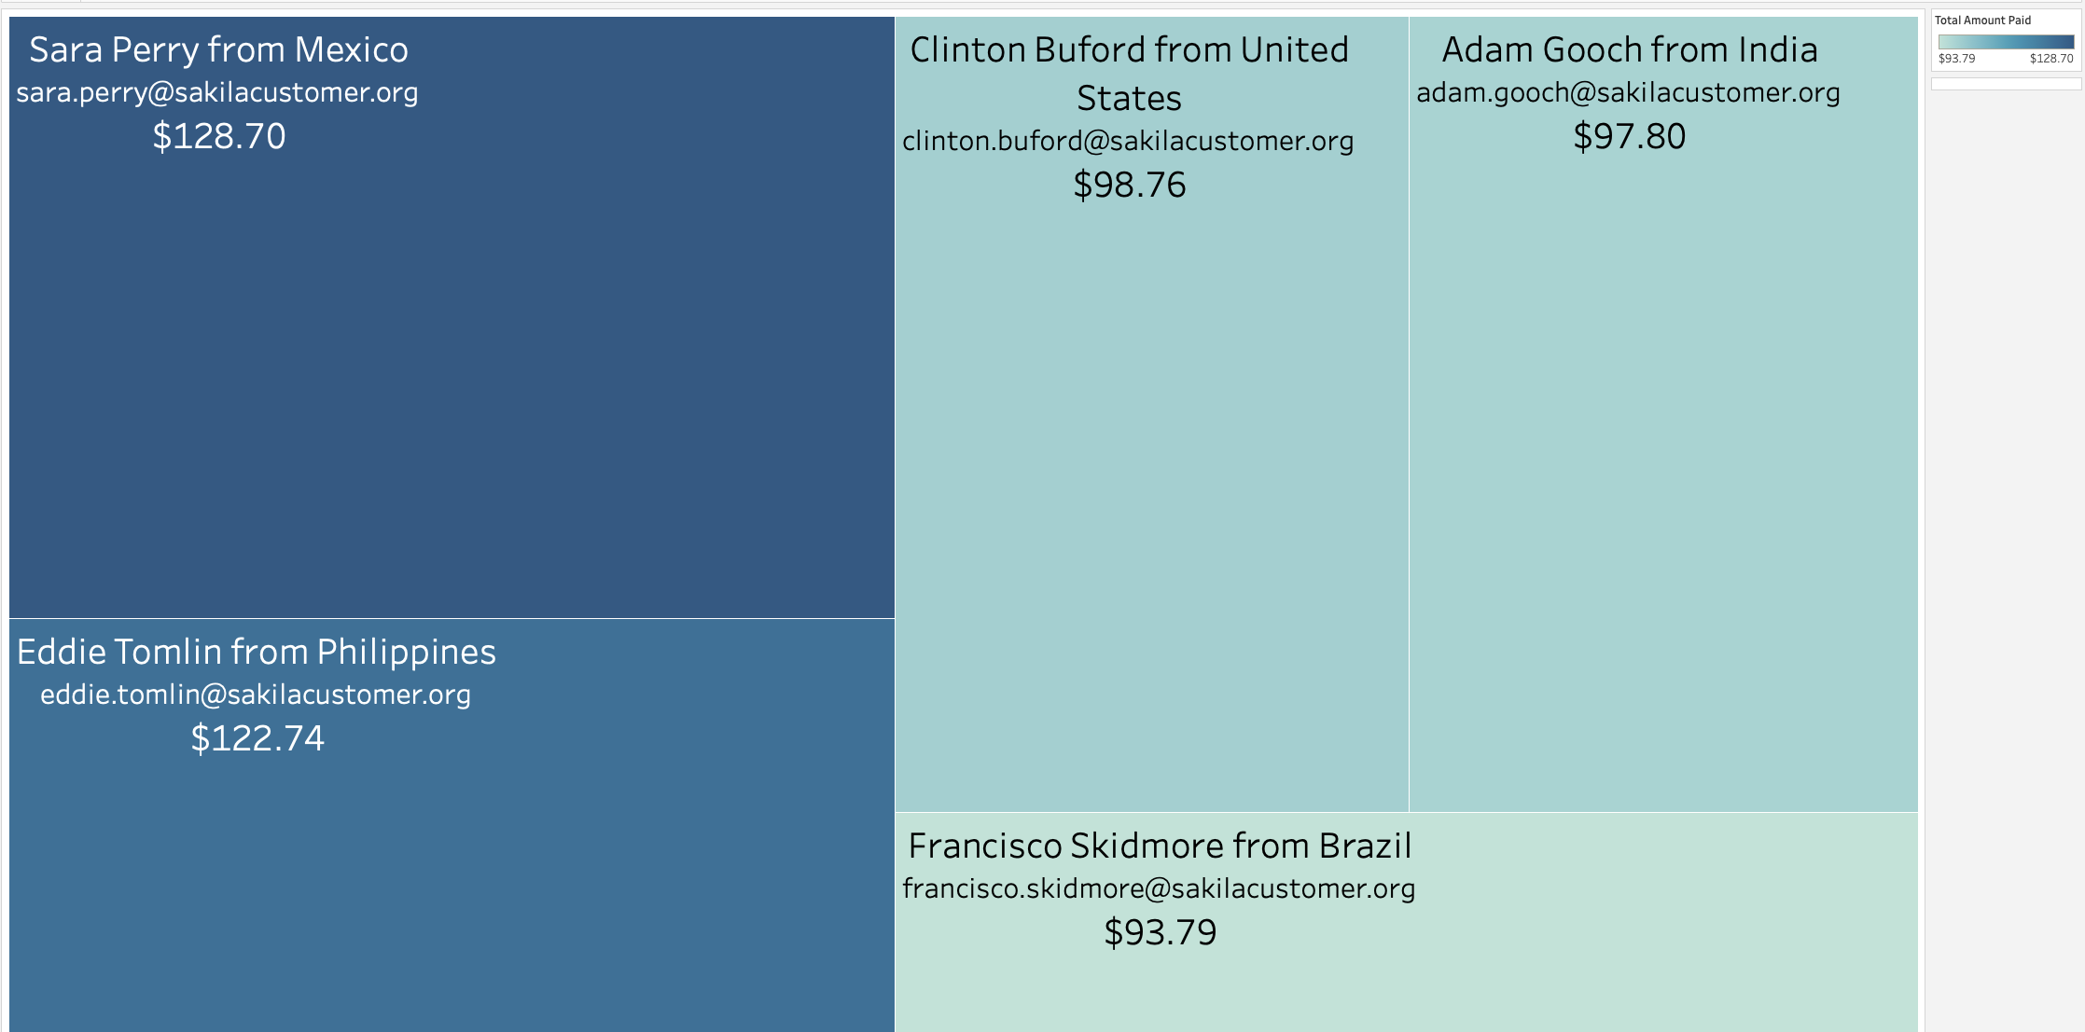
Top 5 customer profiles

Slide 10

WRAP UP
MARKETING : Focus marketing towards Asian countries specifically India, since majority of our customers are based in that location.
RESEARCH : Use the top 5 customer profiles to research what films, and categories are driving Rockbusters revenue.

Slide 11

Thank you
Ngawang Dhundup
Insert email
Tableau Link

